Slide 1

A Brief Introduction to jLINDAW

Slide 2
pLINDAW: A Fuzzy Query Based Data Warehouse System
Kun Wei and Jing Su
Center for Bioinformatics and Systems Biology
Wake Forest School of Medicine

Slide 3
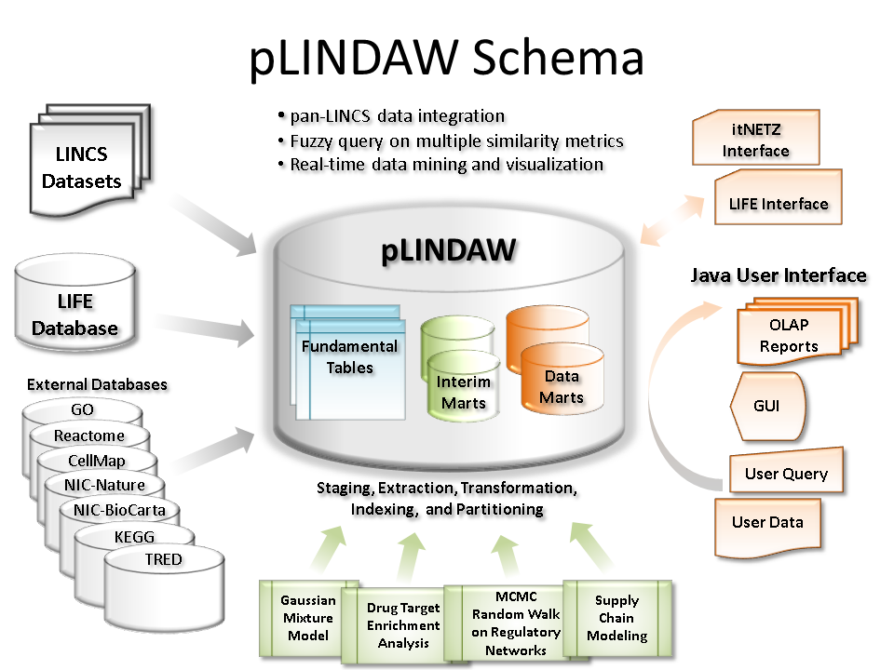
Overview

Slide 4
jLINDAW
The Java-based front-end graphic user interface (jLINDAW) provides a user-friendly portal to access the data analysis and modeling results of the rich datasets of the NIH The Library of Integrated Network-Based Cellular Signatures(LINCS) program.

Slide 5
Software Requirements
Operating system:
Windows XP, Windows 7
Linux
Mac OS X
Dependencies:
JAVA 7 Update 25*
Graphviz 2.31**
*You must install JAVA 7 or later version on the system.
**You can run the jLINDAW just fine without installing Graphviz, except that it cannot draw regulatory network.

Slide 6
Graphviz NOTE:
On Windows, As of version 2.31 , the Visual Studio package no longer alters the PATH variable or accesses the registry at all. So you need to set the PATH variable yourself.

Slide 7
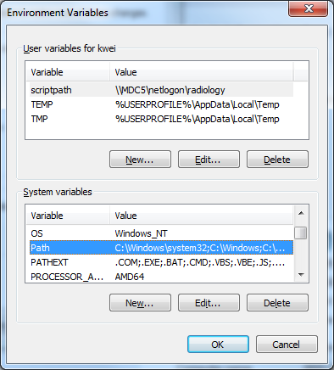
Set Windows PATH environment variable:
From the Desktop, right-click My Computer and click Properties.
Click Advanced System Settings link in the left column.
In the System Properties window click the Environment Variables button.
Click an existing PATH variable, and then click Edit to change its value, and add Graphviz’s bin folder into its value, such as“C:\Program Files (x86)\Graphviz2.34\bin”;

Slide 8
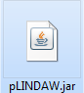
How to Run jLINDAW
Download the JAR package named pLINDAW.jar
Open a command line window whenever you are on your Windows, Linux or MAC. Enter the folder of pLINDAW.jar
Run command “java -jar pLINDAW.jar” directly.

Slide 9
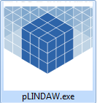
How to Run jLINDAW
Especially, for user convenient on Windows, user can download pLINDAW.exe directly, and double click it to run.

Slide 10
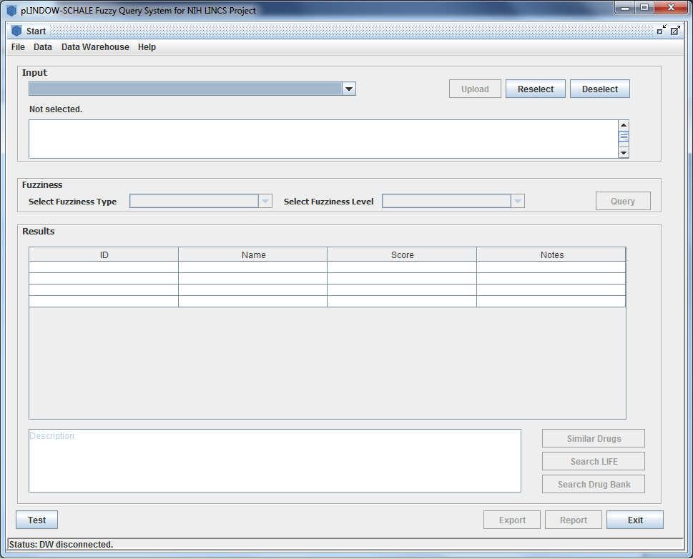
First Glance jLINDAW

Slide 11
Major Functions of jLADAW
Querying drug target signature
Predicting drug similarity
Predicting drug efficacy

Slide 12
Use case of Querying drug target signatures
Input the name(full or partial) or the LINCS ID of the drug or compound
Select Fuzziness Metric Type
Select the Fuzziness Level
Query from Data Warehouse

Slide 13
(1) Input the name(full or partial) or the LINCS ID of the drug or compound
illustrate the steps to select the Drug

Slide 14
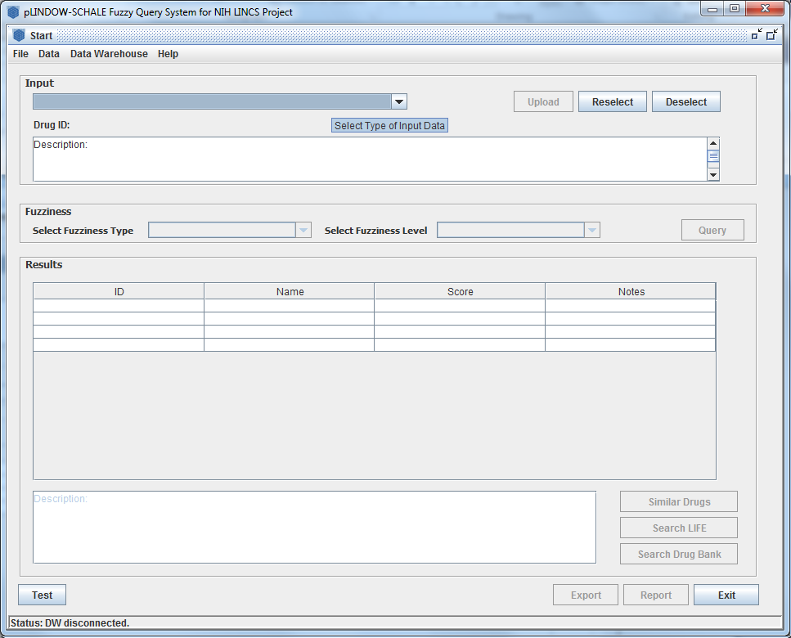
Move mouse to the input ComboBox and slide it down

Slide 15
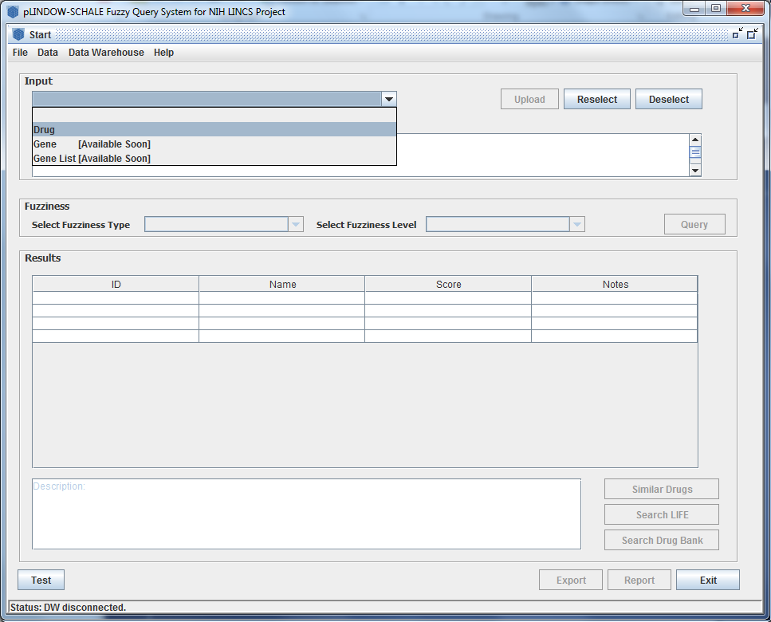
Select the “Drug” item in the slide down list

Slide 16
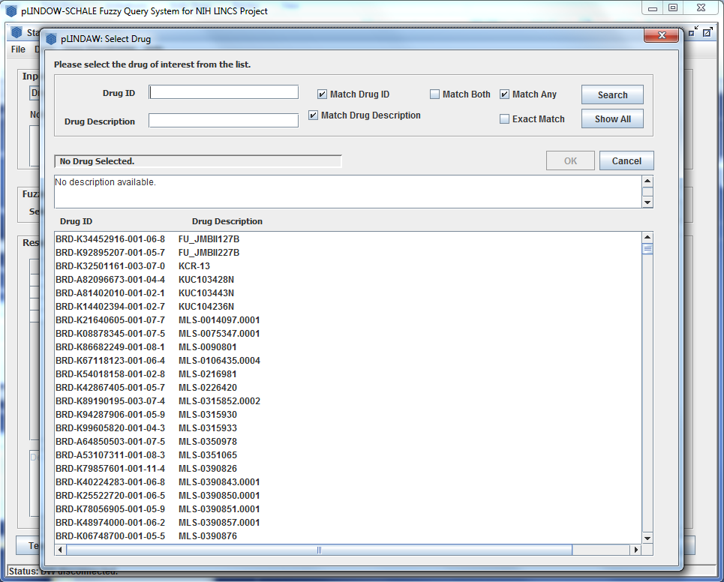
The Select Drug Dialog jumps out

Slide 17
Input Drug Description or LINCS ID
LINCS ID
Description

Slide 18
Check some option boxes

Slide 19
“Match Drug ID”→search the drug by Inputted ID in the left editbox

Slide 20
“Match Drug Description”→Search the drug by inputted description in the left editbox

Slide 21
“Match Both” indicates the result will match both ID and Description inputted in the left two editboxes
AND

Slide 22
“Match Any” indicates the result will match either ID or Description
OR

Slide 23
“Exact Match” indicates that the result have to match either full their ID or Description exactly.
EXACTLY match their ID or Description

Slide 24
Click this “Search” Button to filter the whole Drug or compound

Slide 25
All results which match the conditions above will be displayed in this list.

Slide 26
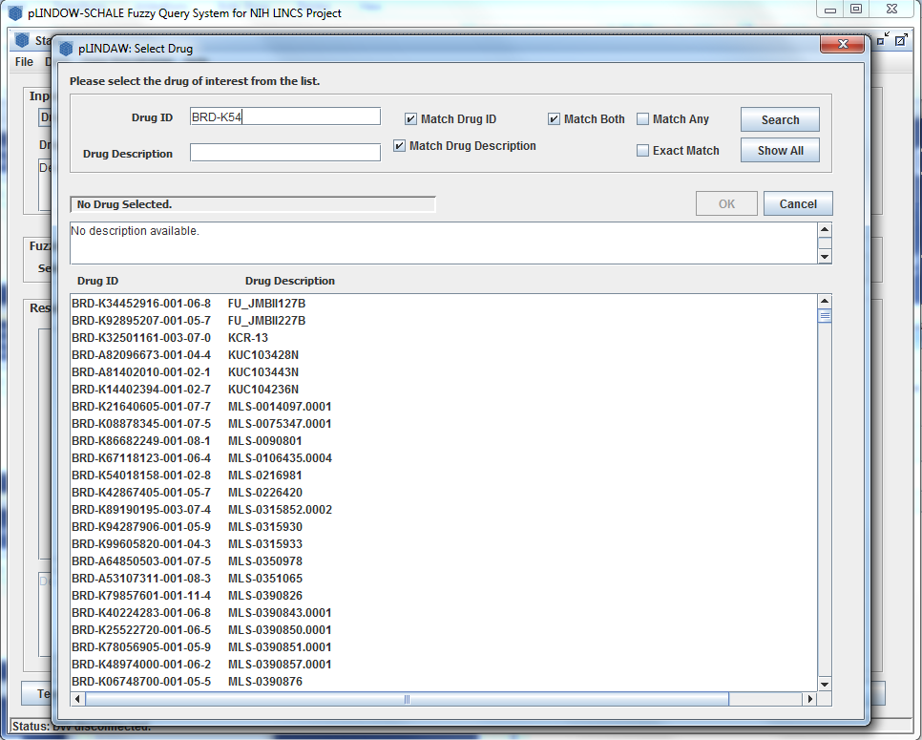
For example: we want to select the Drug which ID is “BRD-K54018158-001-02-8”, but we just remember the prefix “BRD-K54”, so we just input the prefix in the Drug ID Box.

Slide 27
And, check the option

Slide 28
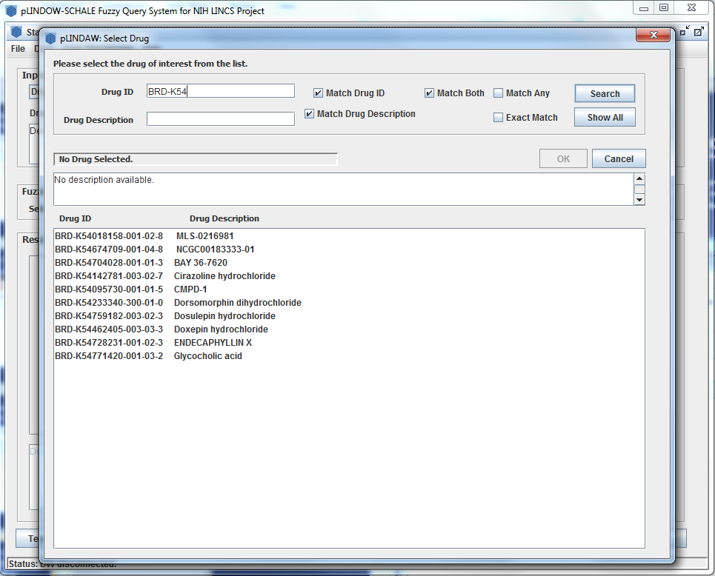
Click “Search” button to powder it
All items which match are displayed in the list.

Slide 29
Search the list and find the expected Drug in the first place

Slide 30
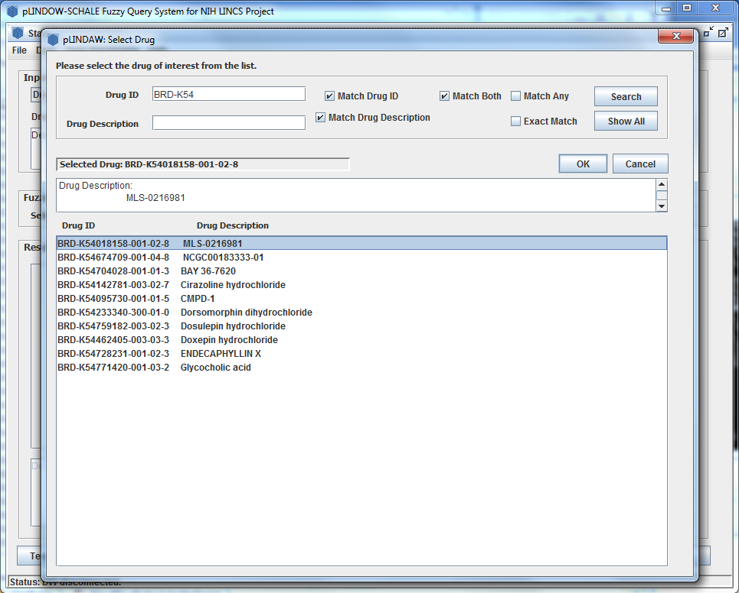
So, we click it to chose the item, then the drug information appear at the above boxes, and the “OK” button changes to available.

Slide 31
We chose the “BRD-K54018158-001-02-8” by Click the “OK” button, or double click the item in the list.

Slide 32
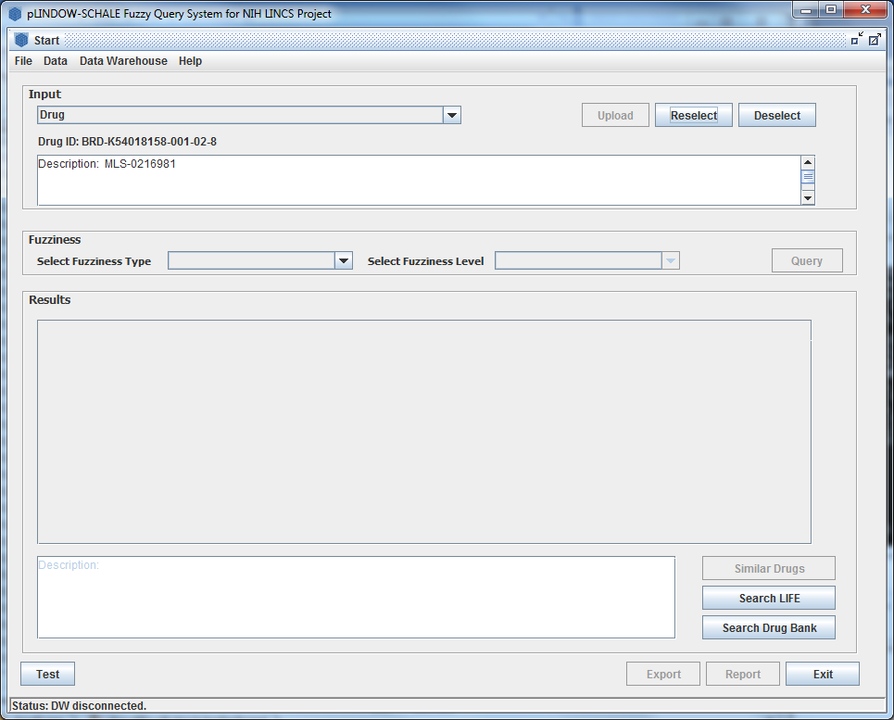
Return main interface, and find the Drug which ID equals “BRD-K54018158-001-02-8” selected.
And the description also appear in the box.

Slide 33
User can reselect Drug by clicking the “Reselect” button.

Slide 34
User also can clear the selected Drug by clicking the “Deselect”, and return the initial state.

Slide 35
(2) Select Fuzziness Metric Type

Slide 36
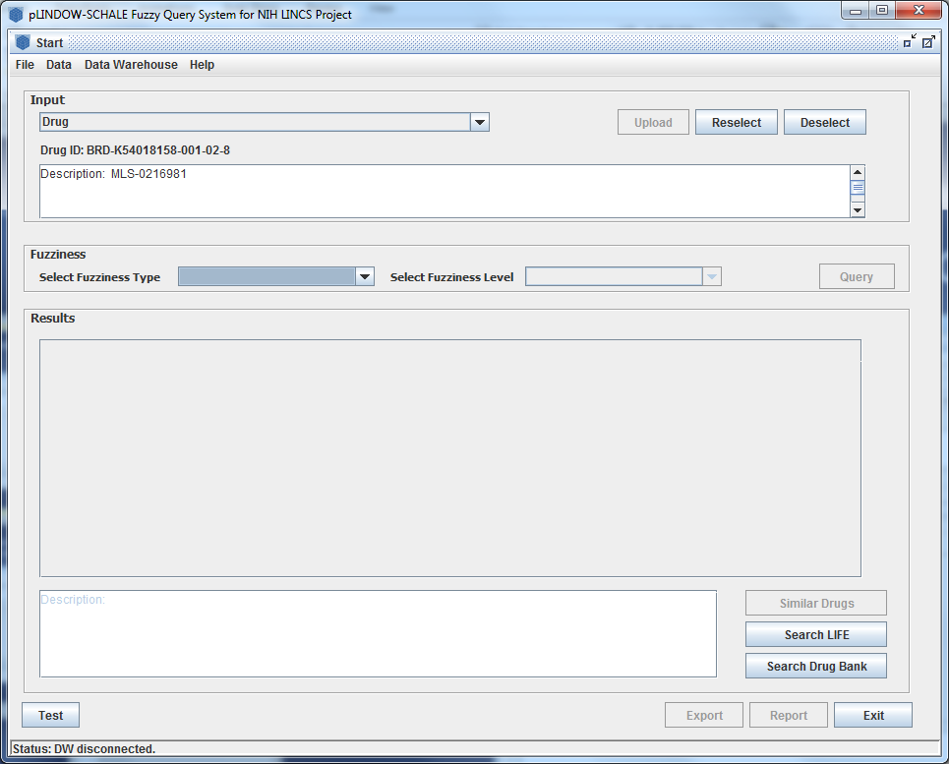
Click the Fuzziness Type comboBox, and Slide it down

Slide 37
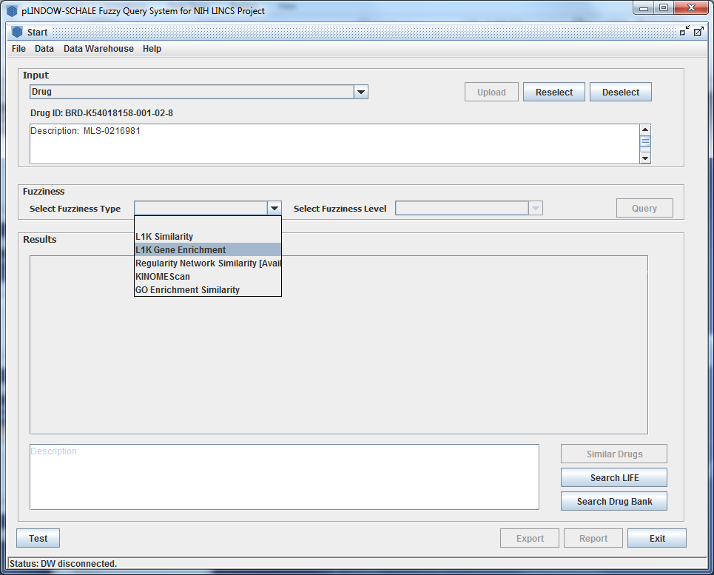
There are five options in the list, here we select the recommended “L1K Gene Enrichment” to illustrate.

Slide 38
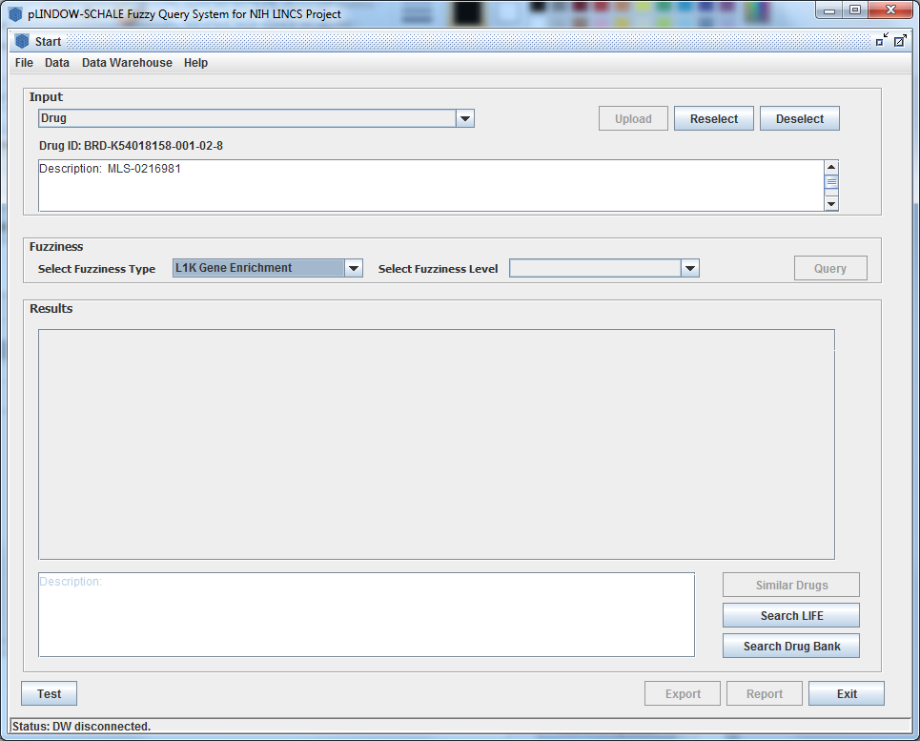
The metric type changes to “L1K Gene Enrichment”.

Slide 39
(3) Select the Fuzziness Level

Slide 40
Click the Fuzziness Level comboBox, slide it down

Slide 41
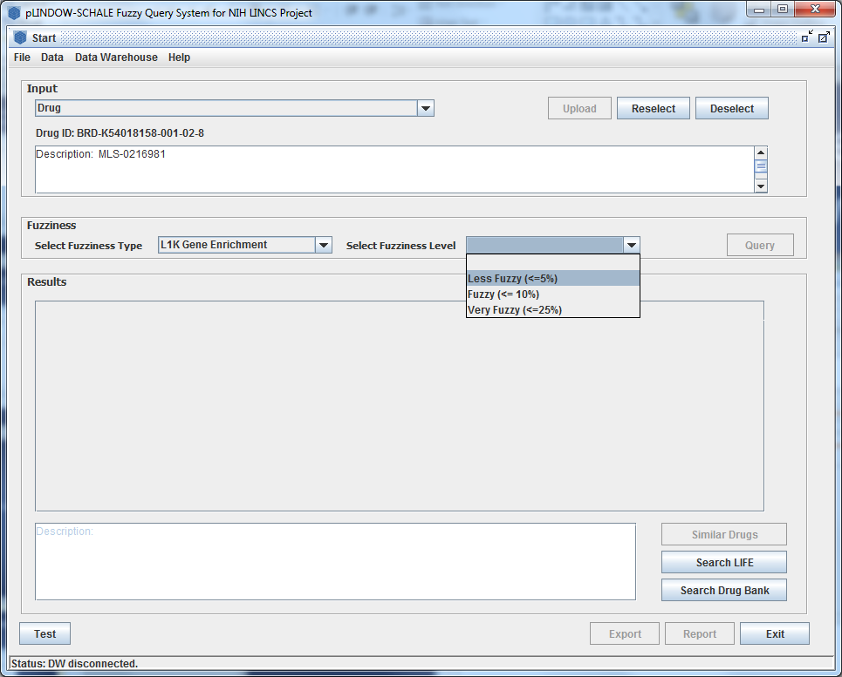
There are three options in the list, here we select the recommended “Less Fuzzy(<=5%)” to illustrate.

Slide 42
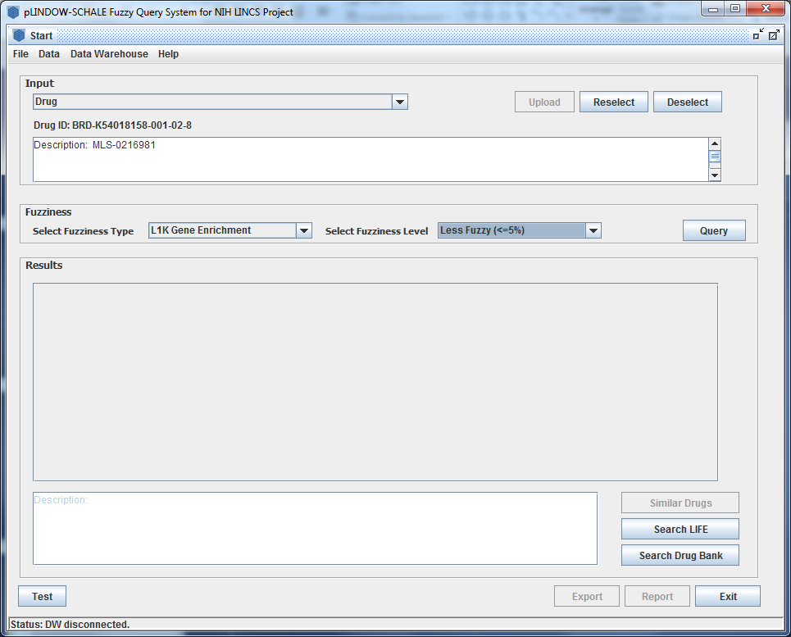
The Fuzziness Level changes to “Less Fuzzy(<=5%)”, and the “Query” changes available.

Slide 43
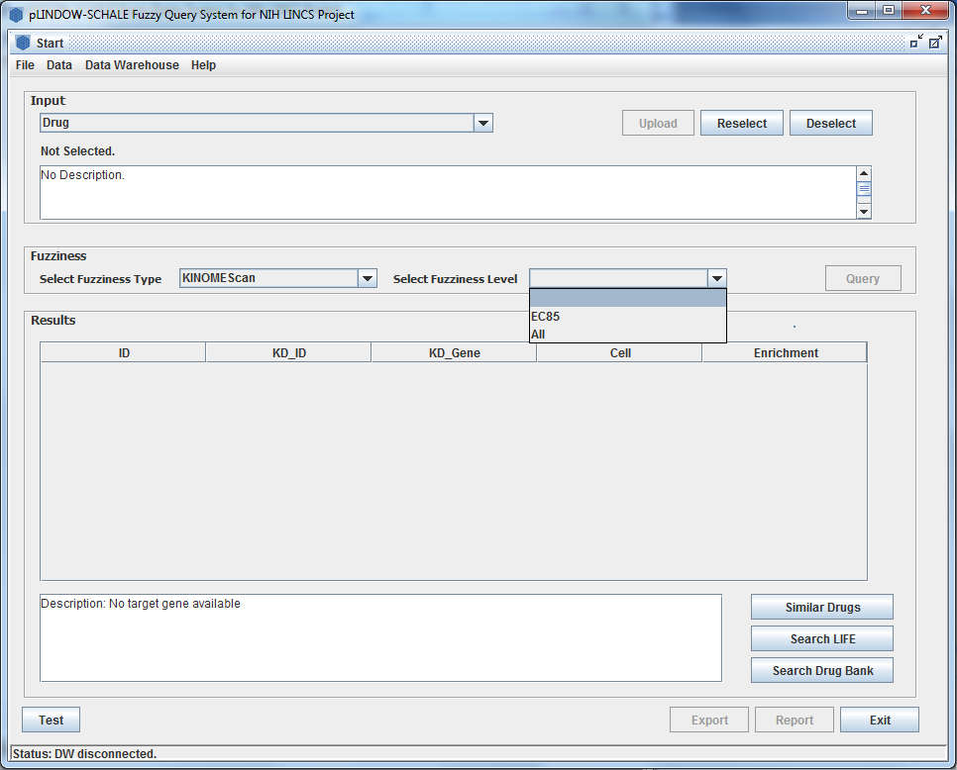
On the other hand, Fuzziness Level just has two options—“EC85”, “ All”, if the Fuzziness Type is “KINOME Scan”.

Slide 44
(4) Querying from Data Warehouse

Slide 45
Just need to click “Query” button and wait for result.

Slide 46
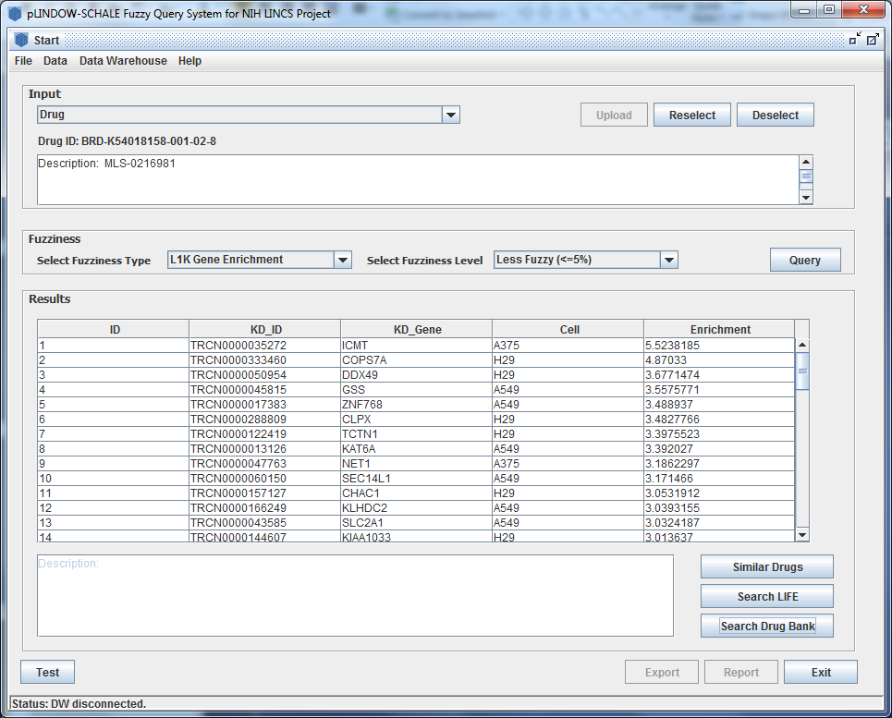
Display Results of the Drug Target Signature
Result

Slide 47
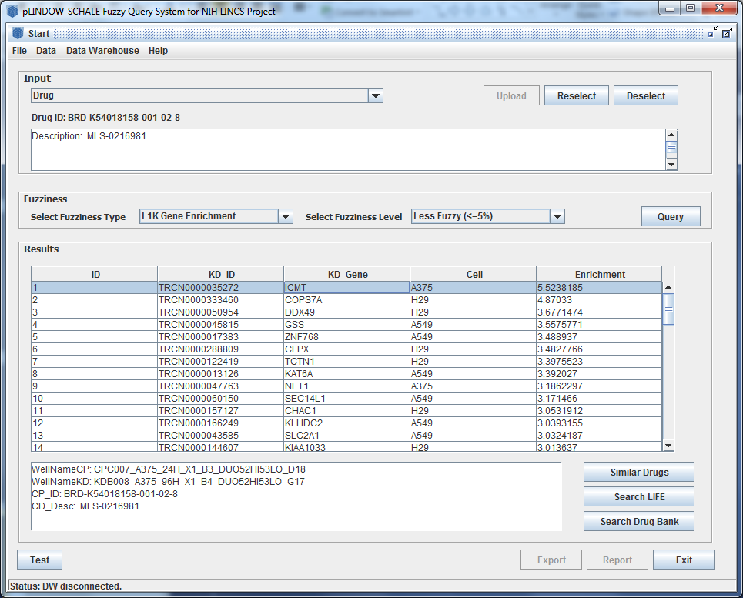
Some detailed information appear in the below box.

Slide 48
Support Searching related information of Gene on other websites
UCSC Gene Browser
GeneCard
NCI-Natural
KEGG
Google

Slide 49
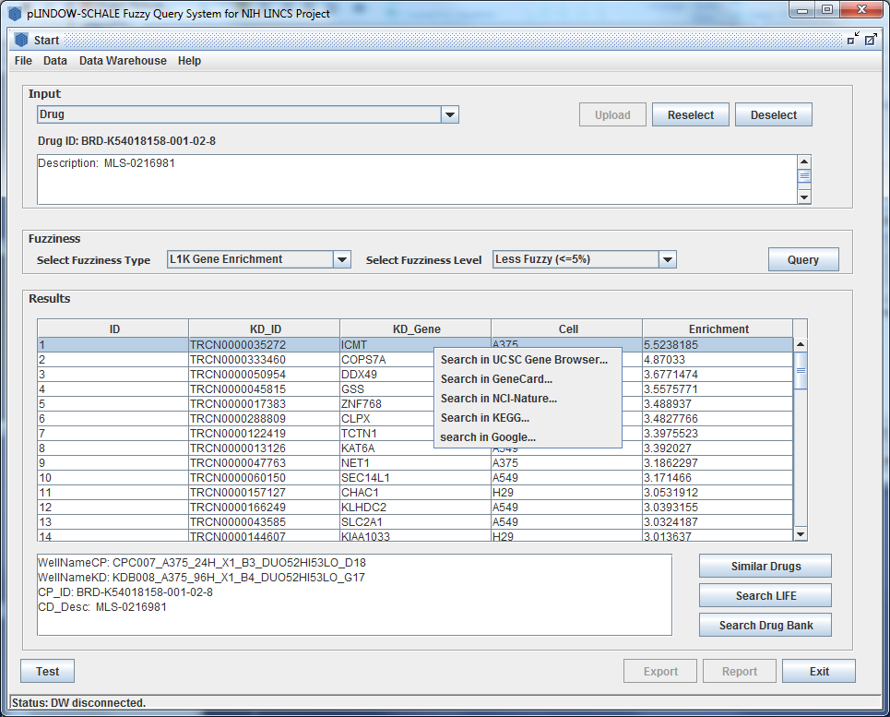
Right click on any gene item in the result list if you want to search them on other websites.

Slide 50
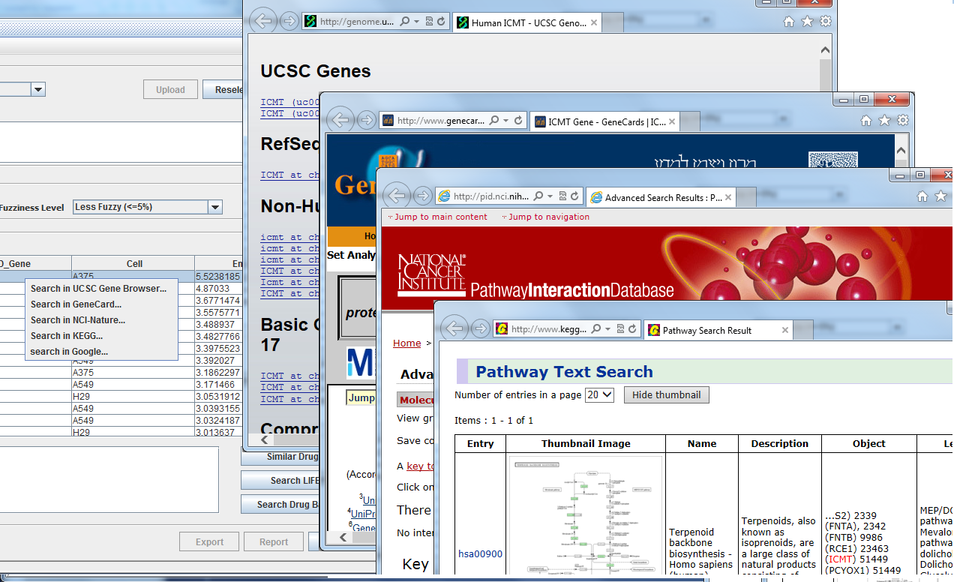

Slide 51
Search Drug on LIFE website

Slide 52
Just click the “Search LIFE” to search on LIFE website after selecting a Drug

Slide 53
Search Drug on Gene Bank website

Slide 54
Just Click the “Search Drug Bank” button, the explorer will open to search.

Slide 55
2. Predicting drug similarity
Select Fuzziness Level
Query from Data Warehouse
Visualize the molecular regulatory network of the two similar drugs

Slide 56
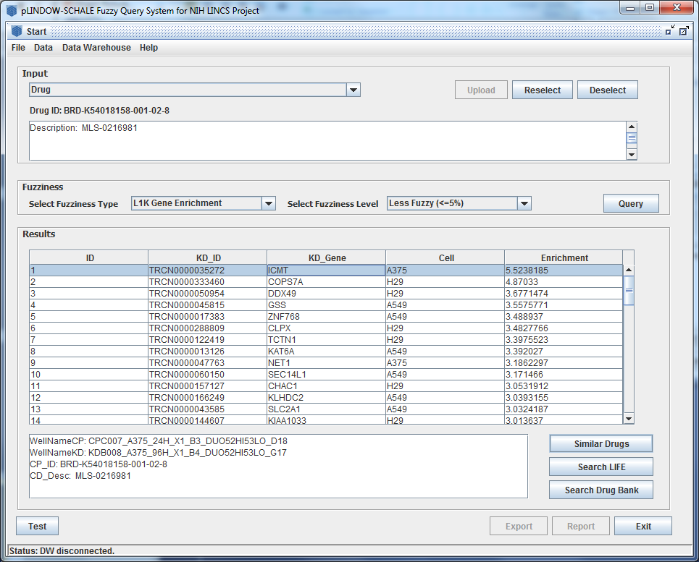
Similar drugs or compounds of the one specified by users can be queried by clicking the “Similar Drugs” button

Slide 57
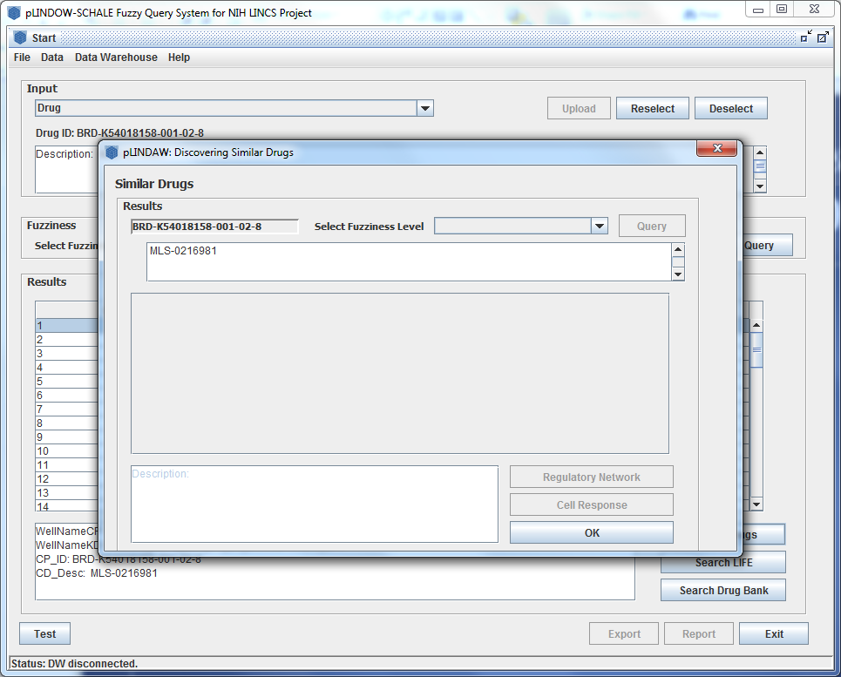
As a example, we continue to search similar drug of “BRD-K54018158-001-02-8”

Slide 58
Select the Fuzziness Level click the Fuzziness Level comboBox, slide it down

Slide 59
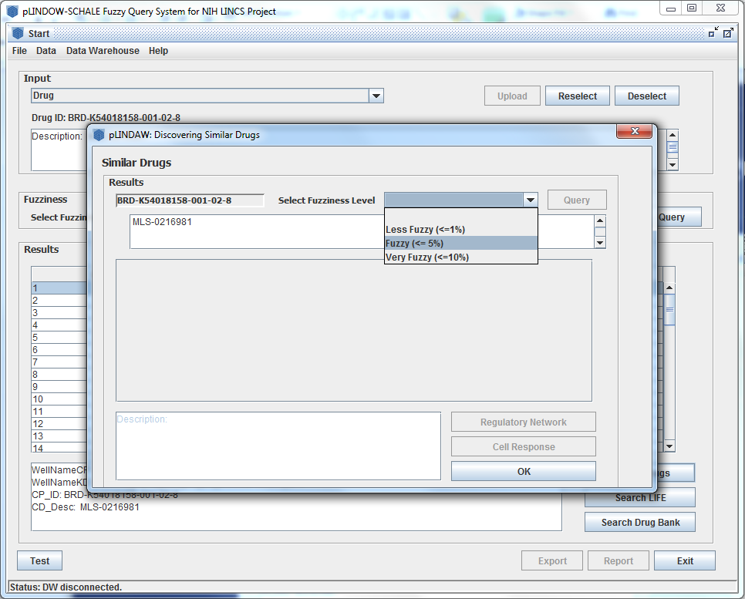
Select a Fuzziness Level in the list

Slide 60
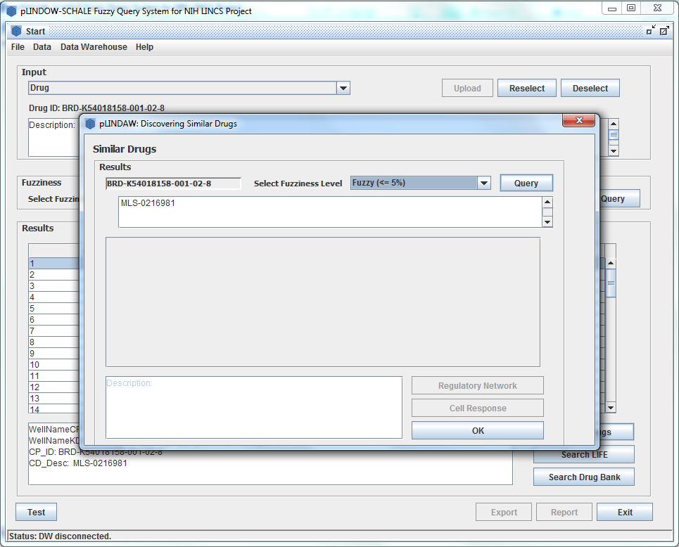
We select the recommended “Fuzzy(<-5%)”, and the “Query” button changes available.

Slide 61
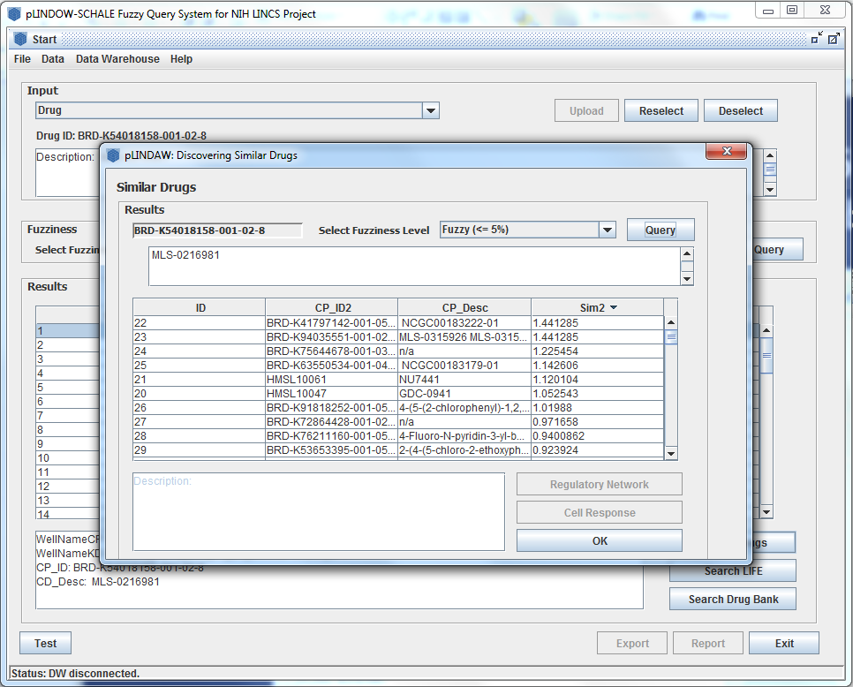
Click the “Query” button to get the similar drugs display in the below list. The name and the similarity of scores will be listed.

Slide 62
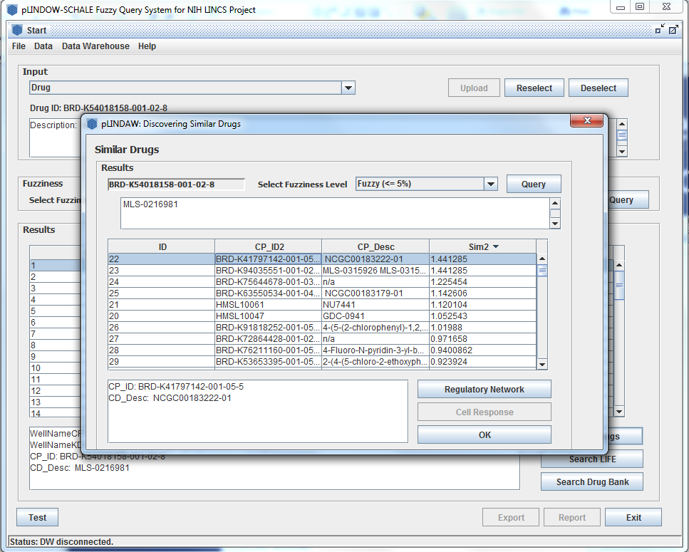
Detailed information show in the edit box below by clicking any similar drug.

Slide 63
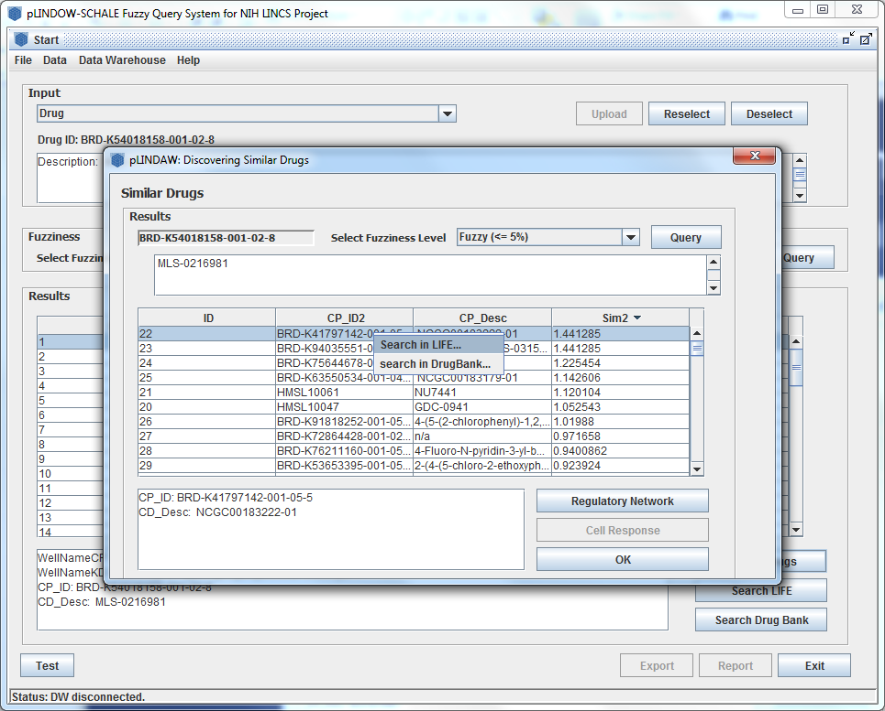
Also, we can directly search these similar drug on LIFE and DrugBank by right clicking any result drug row.

Slide 64
And, we can visualize the molecular regulatory network of the two similar drugs by clicking “Regulatory Network”.

Slide 65
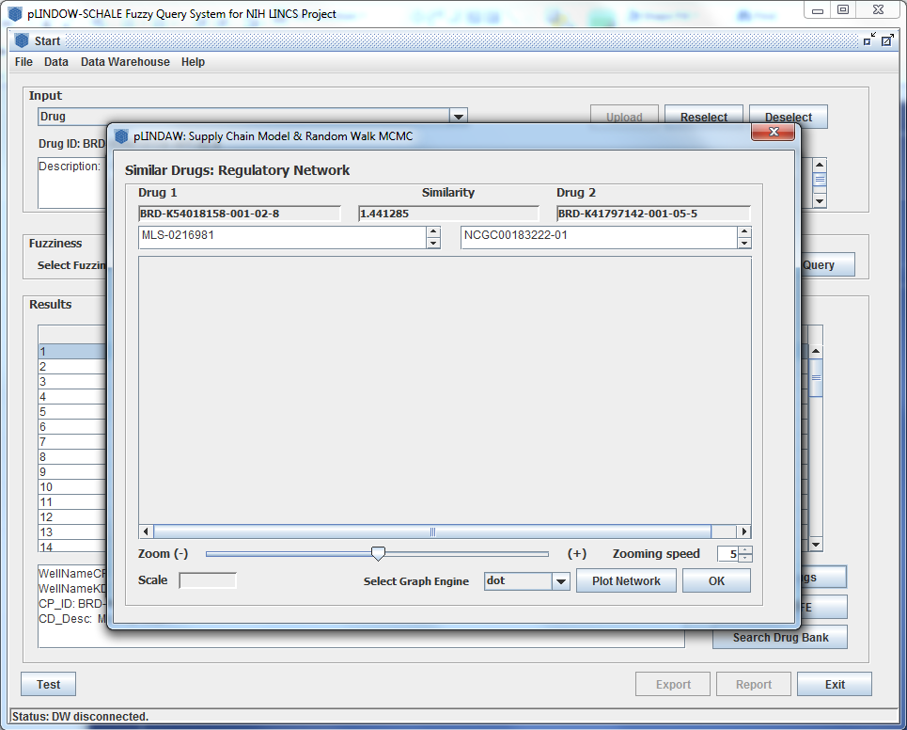
The graph dialog jumps out, the two similar drugs’ name and similarity score are displayed on that.

Slide 66
Power the graph engine to draw by clicking “Plot Network” button which will change to “Stop”.

Slide 67
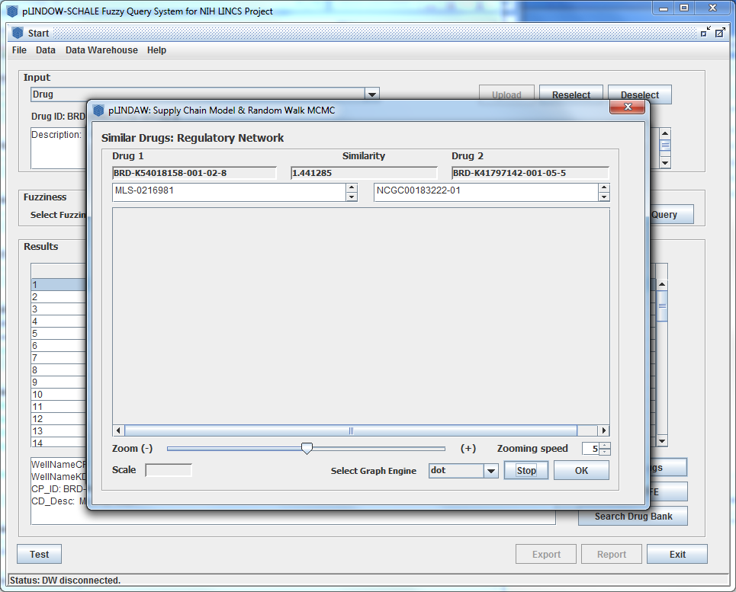
It take several seconds to draw. You can click “Stop” button any time if you have no patience with it.

Slide 68
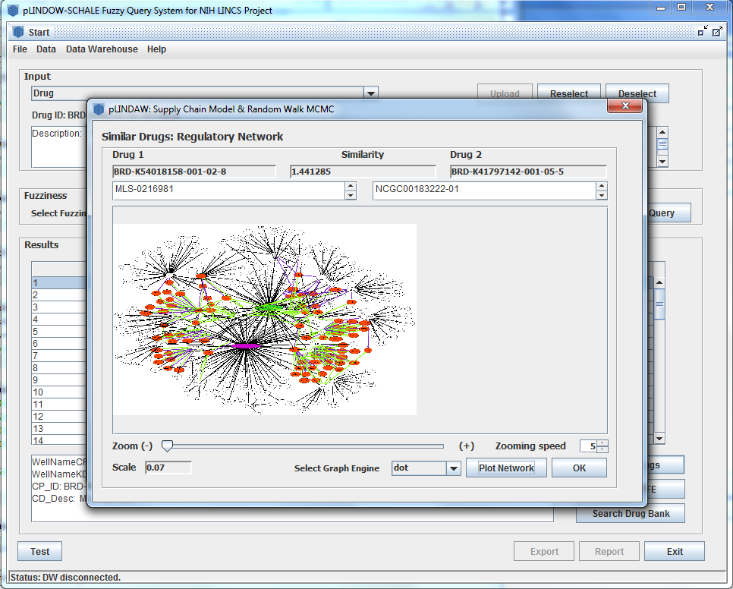
The regulatory network diagram generates in several seconds while the “Stop” button changes to “Plot Network”.

Slide 69
The two similar drugs are labeled in green and purple colors, their shared targets in white and the affected proteins in red.

Slide 70
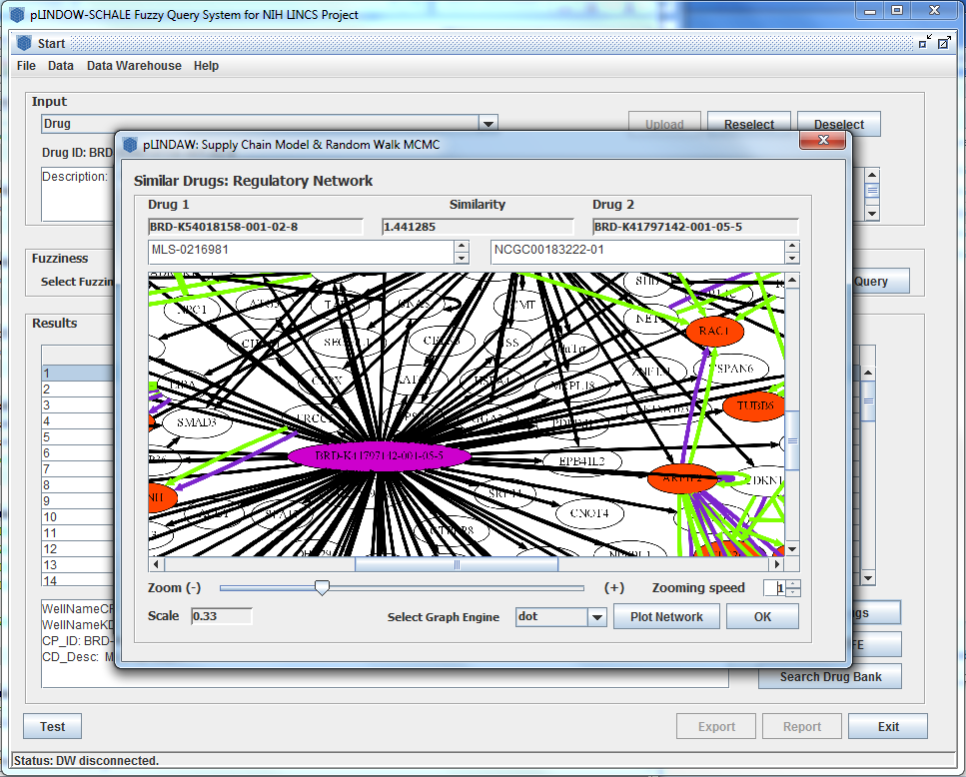
The network diagram can be zoomed in and zoomed out using mouse wheel or drag the “zoom” slider.

Slide 71
The speed of zoom can be adjusted by changing “zoom speed” value.

Slide 72

If users don’t want to use dot graph engine any more, users can change it by reselect the “Graph Engine” option.

Slide 73
3. Predicting drug efficacy
Drug efficacy is modeled and predicted using drug similarity metrics and LINCS drug efficacy library.
Select types of cell lines
Select cell responses
Select the fuzziness level

Slide 74
The “Cell Response” button on the “Discovering Similar Drugs” dialog will lead to the “Cell Responses” dialog, where the profiled or predicted suppression effects on tumor cell growth are listed with scores describing the prediction quality.

Slide 75
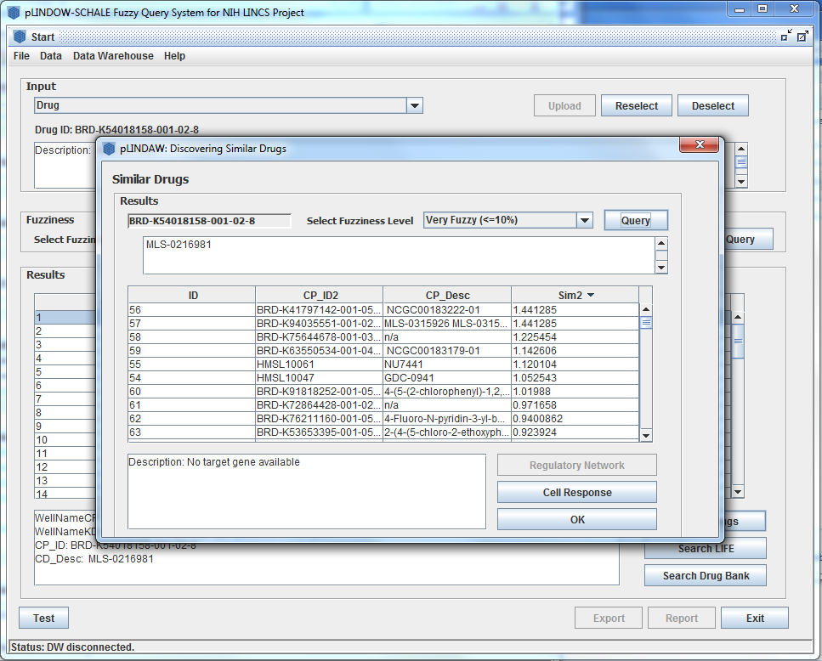
For enabling the “Cell Response” button, we change the Fuzziness similarity Level and Query.

Slide 76
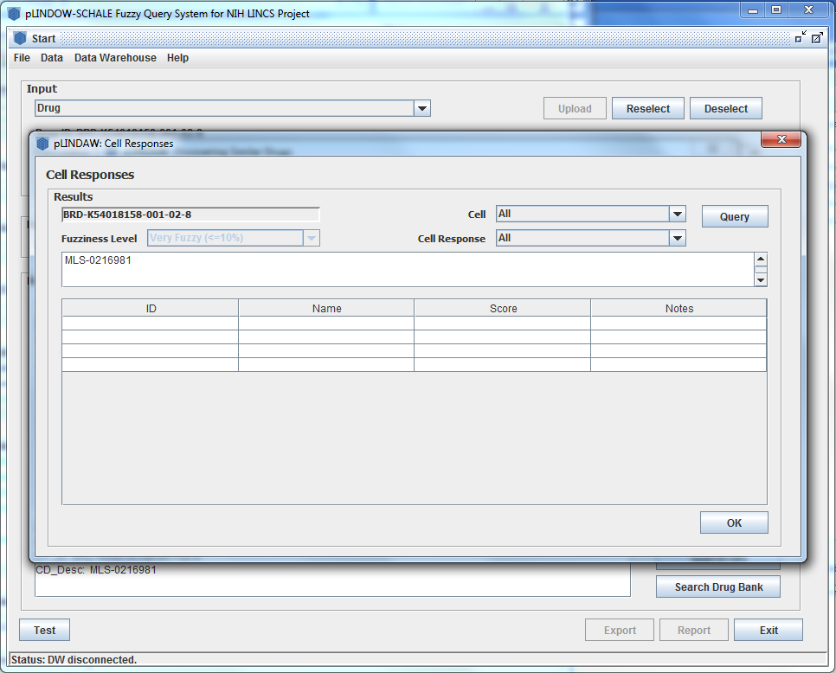
On “Cell Responses” dialog, there are three parameters to select—types of cell lines and cell responses as well as the fuzziness level.

Slide 77
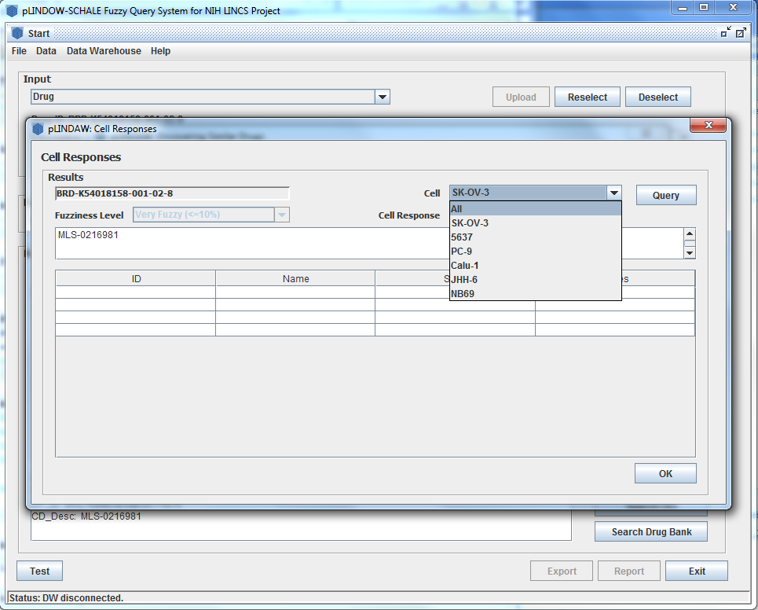
The types cell lines include all, SK-OV-3, 5637, PC-9, Calu-1, JHH-6, NB69.

Slide 78
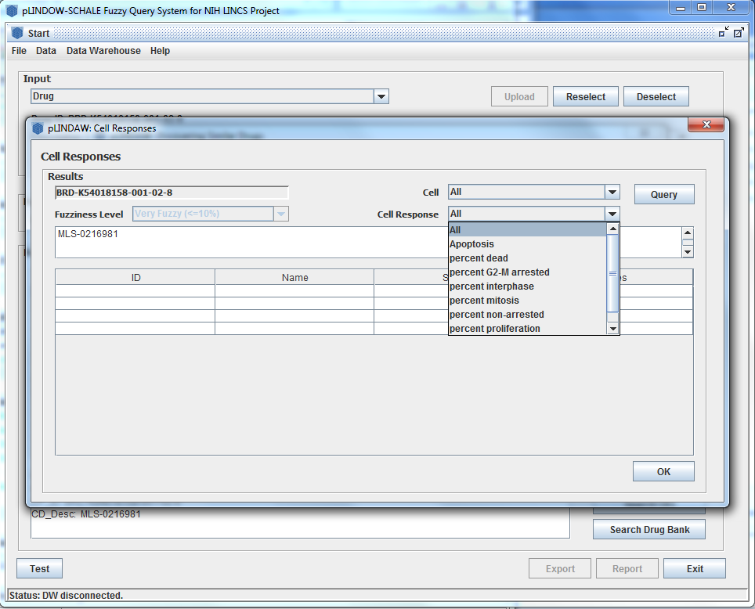
The cell responses include all, Apoptosis, percent dead, percent G2-M arrested, percent interphase, percent mitosis, percent non-arrested, percent proliferation, percent viability.

Slide 79
The Fuzziness Level has only one default option temporarily.

Slide 80
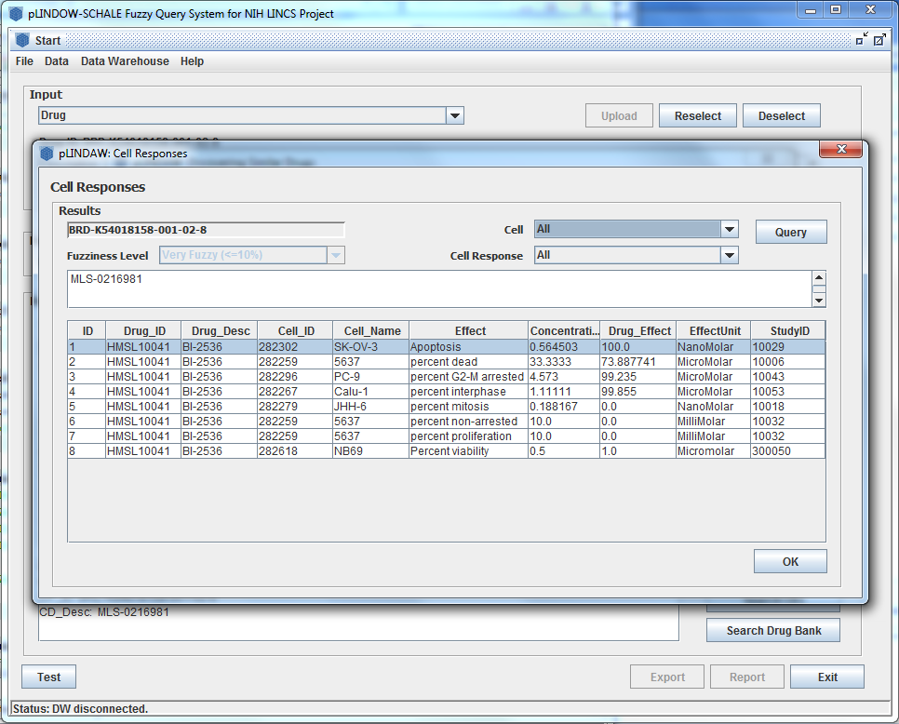
All parameters are specified to narrow down the search. Click “Query” button when finish options.

Slide 81
The profiled or predicted suppression effects on tumor cell growth are listed with scores describing the prediction quality.

Slide 82
Acknowledgement
Xiaobo Zhou, Jing Su, Chenglin Liu, Caty Chung, Hongwei Shao, Hande Kucuk, Christopher Mader, Amar Koleti, Stephan C. Schurer
Department of Radiology, Wake Forest School of Medicine
Center for Bioinformatics and Systems Biology, Wake Forest School of Medicine
Center for Computational Science, University of Miami School of Medicine
Broad Institute
The Texas Advanced Computing Center (TACC) at The University of Texas at Austin for providing HPC resources

